Slide 1
W4153 – Cloud Computing Lecture 4: Microservices(3), Web Content, OAuth2
© Donald F. Ferguson, 2024

Slide 2
W4153 – Cloud Computing Lecture 4: Microservices(3), Web Content, OAuth2
We will start in a few minutes.
© Donald F. Ferguson, 2024

Slide 3

Contents
3 | W4153-F24-4-Web-Content-Mictoservices-DB-Oauth2 © Donald F. Ferguson, 2024

Slide 4
Contents
Database-as-a-Service
Concepts
Example
Web Content and Browser Applications
BLOB Services
Example for web content delivery
Introduction to OAuth2 and OpenIDC.
Microservices Continued
Composition
12 Factor App: Dependencies, Config
SOLID: Dependency Inversion (Injection)
Summary and Next Steps

Slide 5
DBaaS
5 | W4153-F24-4-Web-Content-Mictoservices-DB-Oauth2 © Donald F. Ferguson, 2024

Slide 6
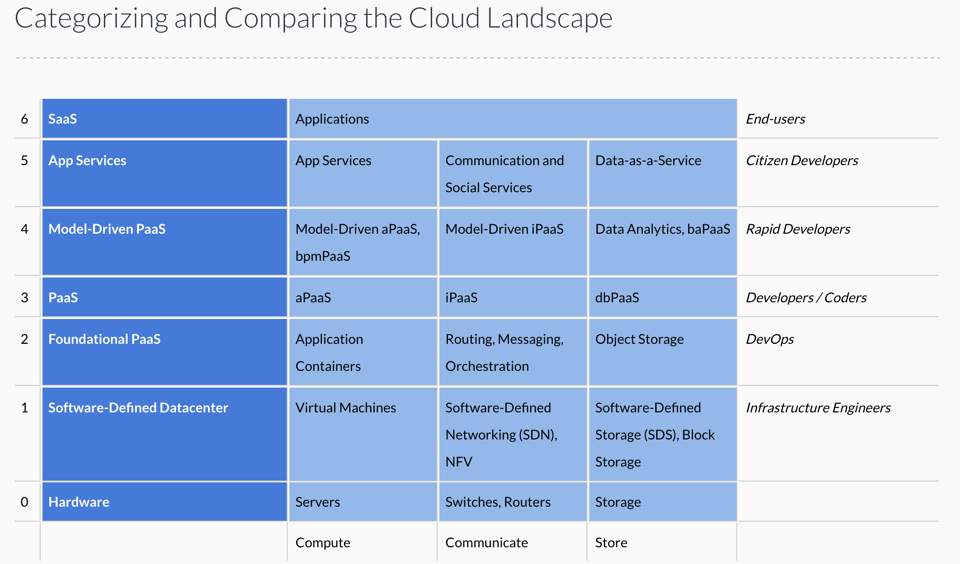
Cloud Concepts – One Perspective
http://www.theenterprisearchitect.eu/blog/2013/10/12/the-cloud-landscape-described-categorized-and-compared/

Slide 7
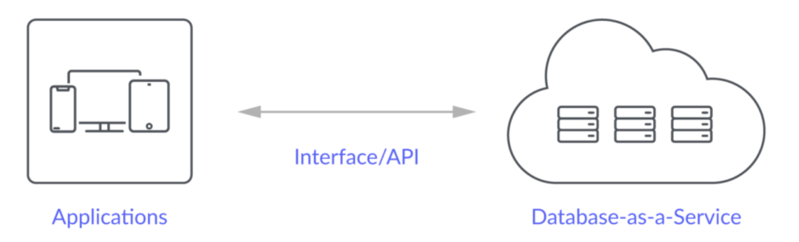
Database-as-a-Service
“A cloud database is a database that typically runs on a cloud computing platform and access to the database is provided as-a-service. There are two common deployment models: users can run databases on the cloud independently, using a virtual machine image, or they can purchase access to a database service, maintained by a cloud database provider. Of the databases available on the cloud, some are SQL-based and some use a NoSQL data model.
Database services take care of scalability and high availability of the database. Database services make the underlying software-stack transparent to the user.” (Wikipedia)
Let’s take a look at 3: Relational Data Service, Dynamo DB, MongoDB (Compass)

Slide 8
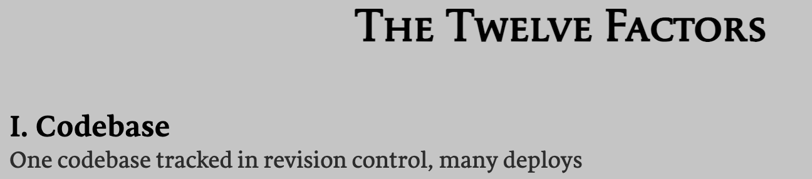
Example and Walkthrough
My simple approach (We do something for sophisticated in practice):
A simple full-stack web application has 3 “C4 containers:”
UI application that runs in the browser.
Microservice implementation in an application server.
Database “application” in a database management system.
There is a single implementation of each “container.” There are two deployments for each container:
Local (on my development laptop)
Deployed in the cloud.
I have 3 configurations that I can use for testing.
Walkthrough of AWS approach.
DB setup and configuration, DataGrip
Environment variables
Microservice
Google equivalent.
Test Config | UI | Microservice | DB App
All local | Angular Embedded | Local FastAPI | Local MySQL
Mostly Local | Angular Embedded | Local FastAPI | DBaaS
Mostly Cloud | Angular Embedded | Cloud Deployed | DBaaS
Fully Deployed | Cloud Deployed | Cloud Deployed | DBaaS

Slide 9
BLOBs Web Content
9 | W4153-F24-4-Web-Content-Mictoservices-DB-Oauth2 © Donald F. Ferguson, 2024

Slide 10
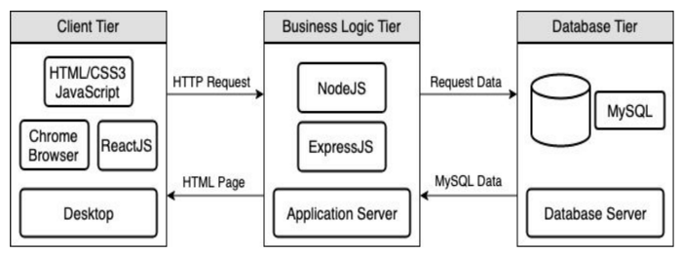
Full Stack Web Application – Reminder
https://levelup.gitconnected.com/a-complete-guide-build-a-scalable-3-tier-architecture-with-mern-stack-es6-ca129d7df805
We have seen how to use Flask (or FastAPI) to implement an endpoint (a set of paths):
Some of the paths can run application logic and return the result data.
Some can return pages that a browser can render. Basically, these paths are returning the “client application” to the browser to execute, and may have API calls in JavaScript/Typescript.
The page can be static and returned “as is.” There are also template languages for parameterized returns, e.g. Jinja2
But, running application logic and simply delivering files are two different “concerns.”
Having one runtime implement both would violate the SOLID principle.
The design points are different: “You can be a floor wax or a mouth wash, but not both.”
So, we need a separate “web server.”

Slide 11
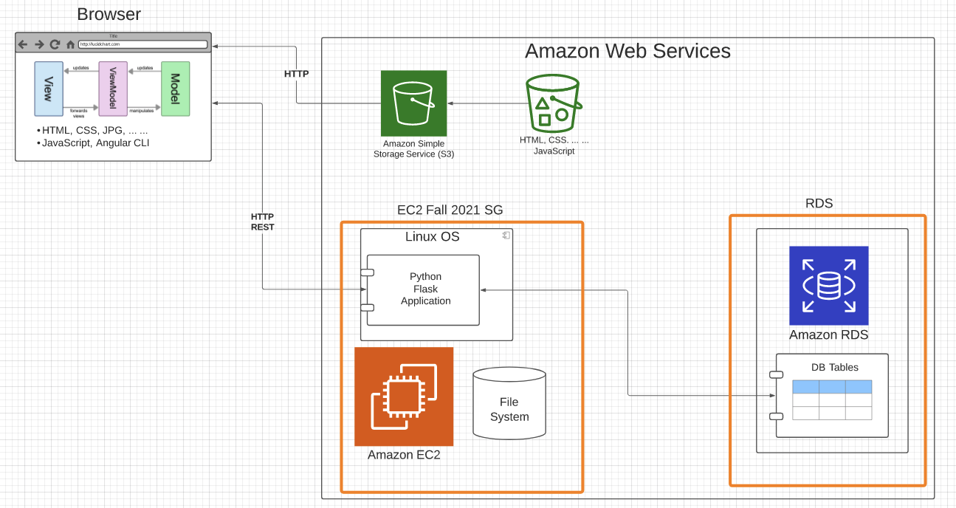

Slide 12
BLOB: Binary Large Object
Definitions:
“A binary large object (BLOB or blob) is a collection of binary data stored as a single entity. Blobs are typically images, audio or other multimedia objects, though sometimes binary executable code is stored as a blob. They can exist as persistent values inside some databases or version control system, or exist at runtime as program variables in some programming languages.” (https://en.wikipedia.org/wiki/Binary_large_object)
“Blob is the data type in MySQL that helps us store the object in the binary format. It is most typically used to store the files, images, etc media files for security reasons or some other purpose in MySQL.” (https://www.educba.com/mysql-blob/)
Intent:
File systems are not good for many application scenarios, which is why database management systems emerged.
Database management systems implement structured (or semi-structured) data, e.g. tables.
Database BLOBs were a way to have some “big things” as table or document properties.

Slide 13
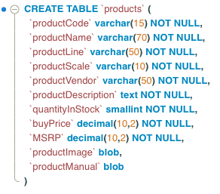
Simple Example
Structured or semi-structured information about an entity.
Queryable
Editable on forms
etc.
Unstructured: A file-like, opaque property associated with the entity. This is a BLOB.
URLs have primarily replaced BLOBs.

Slide 14
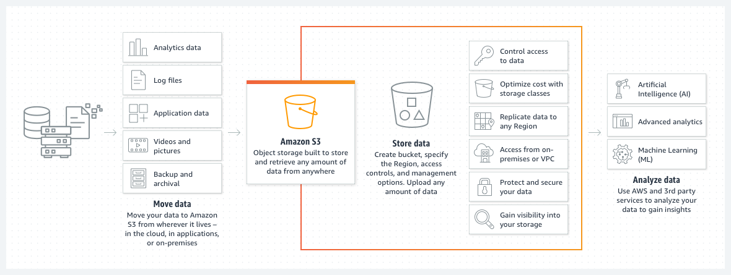
Amazon S3
There are equivalent capabilities on most clouds.

Slide 15
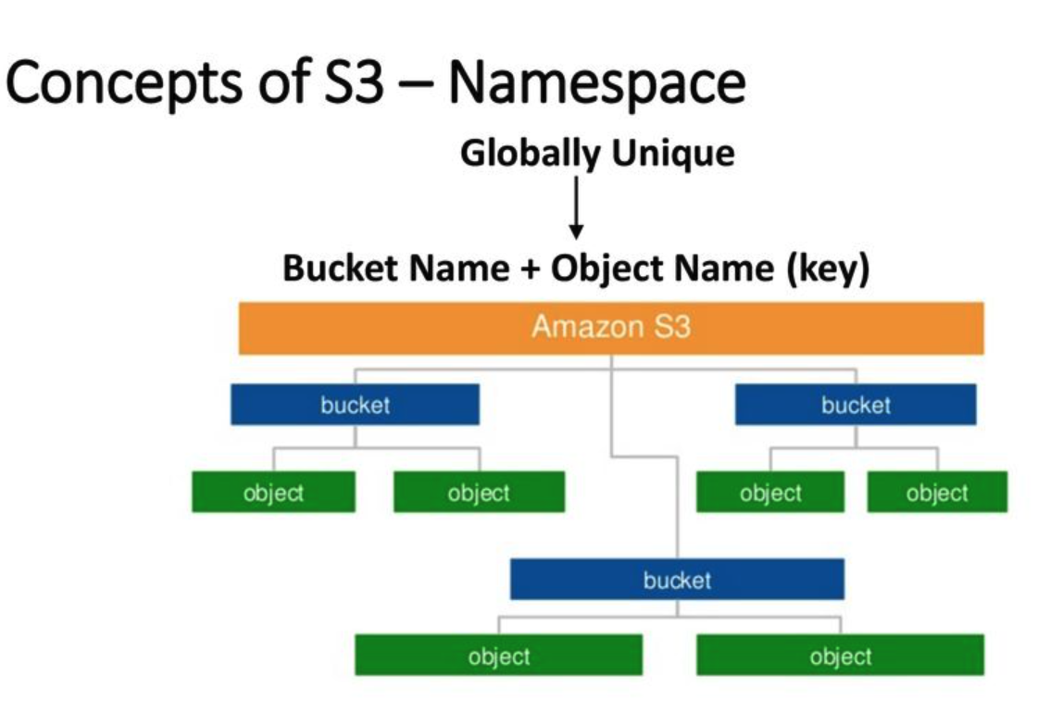
AWS S3
Can support a logical hierarchy with a convention on keys.
x/y
x/z
x/y/z
... ...
Acts kind of file system like, but is really just key strings.

Slide 16
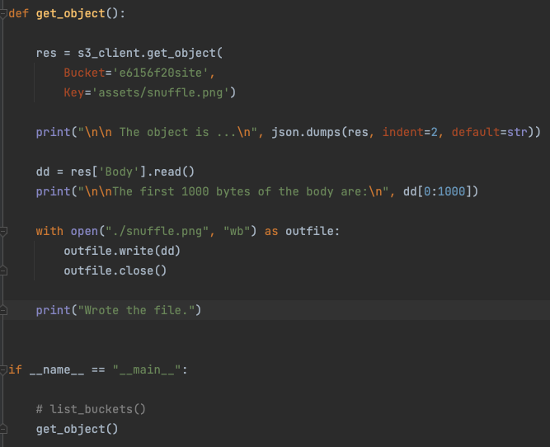
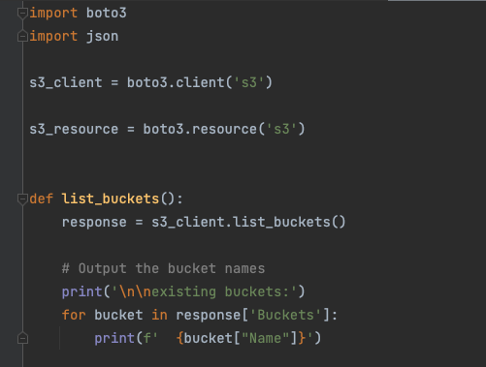
Simple S3 Example
See simple_examples/S3

Slide 17
Simple Example
https://e6156f20site.s3.us-east-2.amazonaws.com/index.html
Why not deliver static content out of the application? After all it is serving HTTP.
You get a lot of things figured out and implemented for you.
Scalability
Caching
Availability
Encryption
etc.
You want to focus on things that are your apps value, and not implementing commodity functions.
In the Ansys cloud platform, we use BLOBs to store CAD files, images, complex result data files, … …

Slide 18
OpenID, OAuth2
18 | W4153-F24-4-Web-Content-Mictoservices-DB-Oauth2 © Donald F. Ferguson, 2024

Slide 19
OpenIDC and Oauth2
OAuth 2.0
OAuth 2.0 is a protocol for authorizing client applications to access protected resources. OAuth 2.0 provides consented access and restricts actions of what the client application can perform on resources on behalf of the user, without ever sharing the user’s credentials.
OpenID Connect
OpenID Connect is an identity layer on top of the OAuth 2.0 protocol. It allows Clients to verify the identity of the End-User based on the authentication performed by an Authorization Server, as well as to obtain basic profile information about the End-User in an interoperable manner.
OpenID exists to enable Federated Authentication, where users are able to authenticate with the same identity across multiple web applications. Both users and web applications trust identity providers, such as Google, Yahoo!, and Facebook, to store user profile information and authenticate users on behalf of the application. This eliminates the need for each web application to build its own custom authentication system, and it makes it much easier and faster for users to sign up and sign into sites around the Web.
https://medium.com/software-development-turkey/understanding-oauth-2-0-and-openid-connect-777eb1fc27f

Slide 20
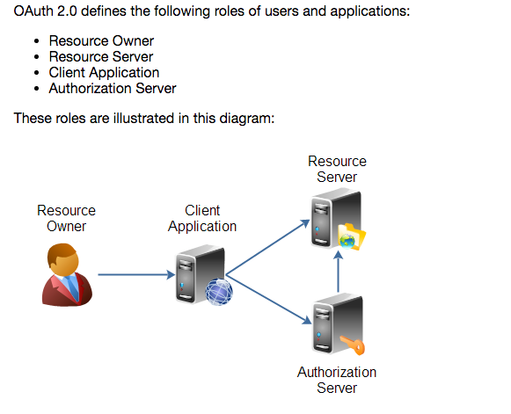
Overview (http://tutorials.jenkov.com/oauth2/index.html)
Resource Owner
Controls access to the “data.”
Facebook user, LinkedIn user, …
Resource Server
The website that holds/manages info.
Facebook, LinkedIn, ...
And provides access API.
Client Application
“The product you implemented.”
Wants to read/update
“On your behalf”
The data the data that the Resource Server maintains, e.g. posts, status, tweets, ...
Authorization Server
Grants/rejects authorization
Based on Resource Owner decisions.
Usually (logically) the same as Resource Server.

Slide 21
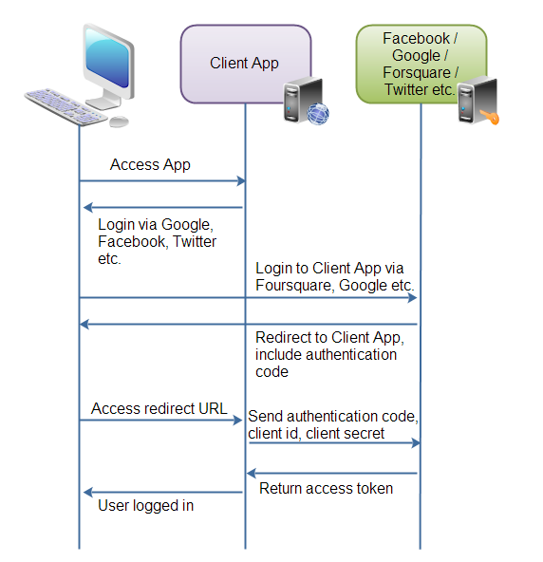
Roles/Flows
User Clicks “Logon with XXX”
Redirect user to XXX
With Client App application ID.
And permissions app requests.
Code MAY have to call Resource Server to get a token to include in redirect URL.
Browser redirected to XXX
Logon on to XXX prompt.
Followed by “do you grant permission to …”
Clicking button drives a redirect back to Client App. URL contains a temporary token.
User/Browser
Redirected to Client App URL with token.
Client App calls XXX API
Obtains access token.
Returns to User.
Client App can use access token on API calls.

Slide 22
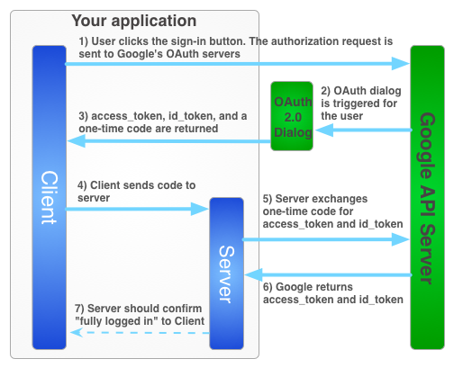
Google

Slide 23
Walkthrough
There are good tutorials: https://medium.com/software-development-turkey/understanding-oauth-2-0-and-openid-connect-777eb1fc27f
Show Coupon App code
Show the in-progress coupon issue app.
Google Cloud setup
Consent
URLs
Overall setup of application:
URLs
Local example
Cloud example

Slide 24
Microservices Continued
24 | W4153-F24-4-Web-Content-Mictoservices-DB-Oauth2 © Donald F. Ferguson, 2024

Slide 25
Composites
Introduction
25 | W4153-F24-4-Web-Content-Mictoservices-DB-Oauth2 © Donald F. Ferguson, 2024

Slide 26
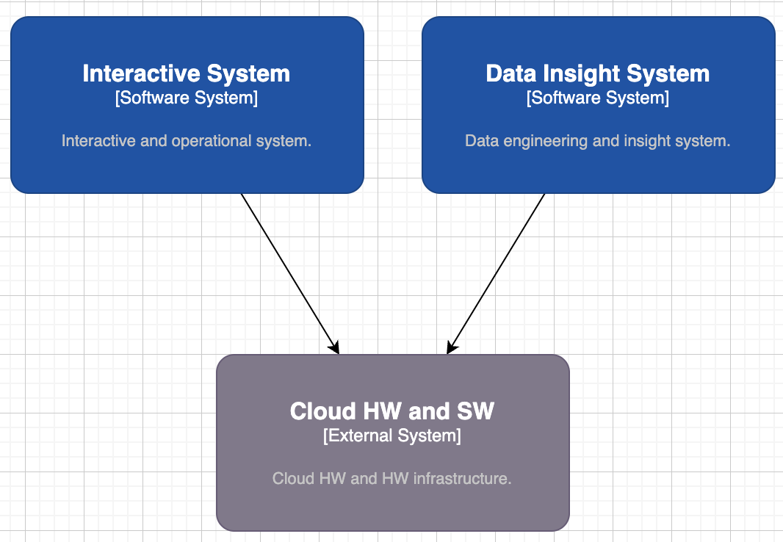
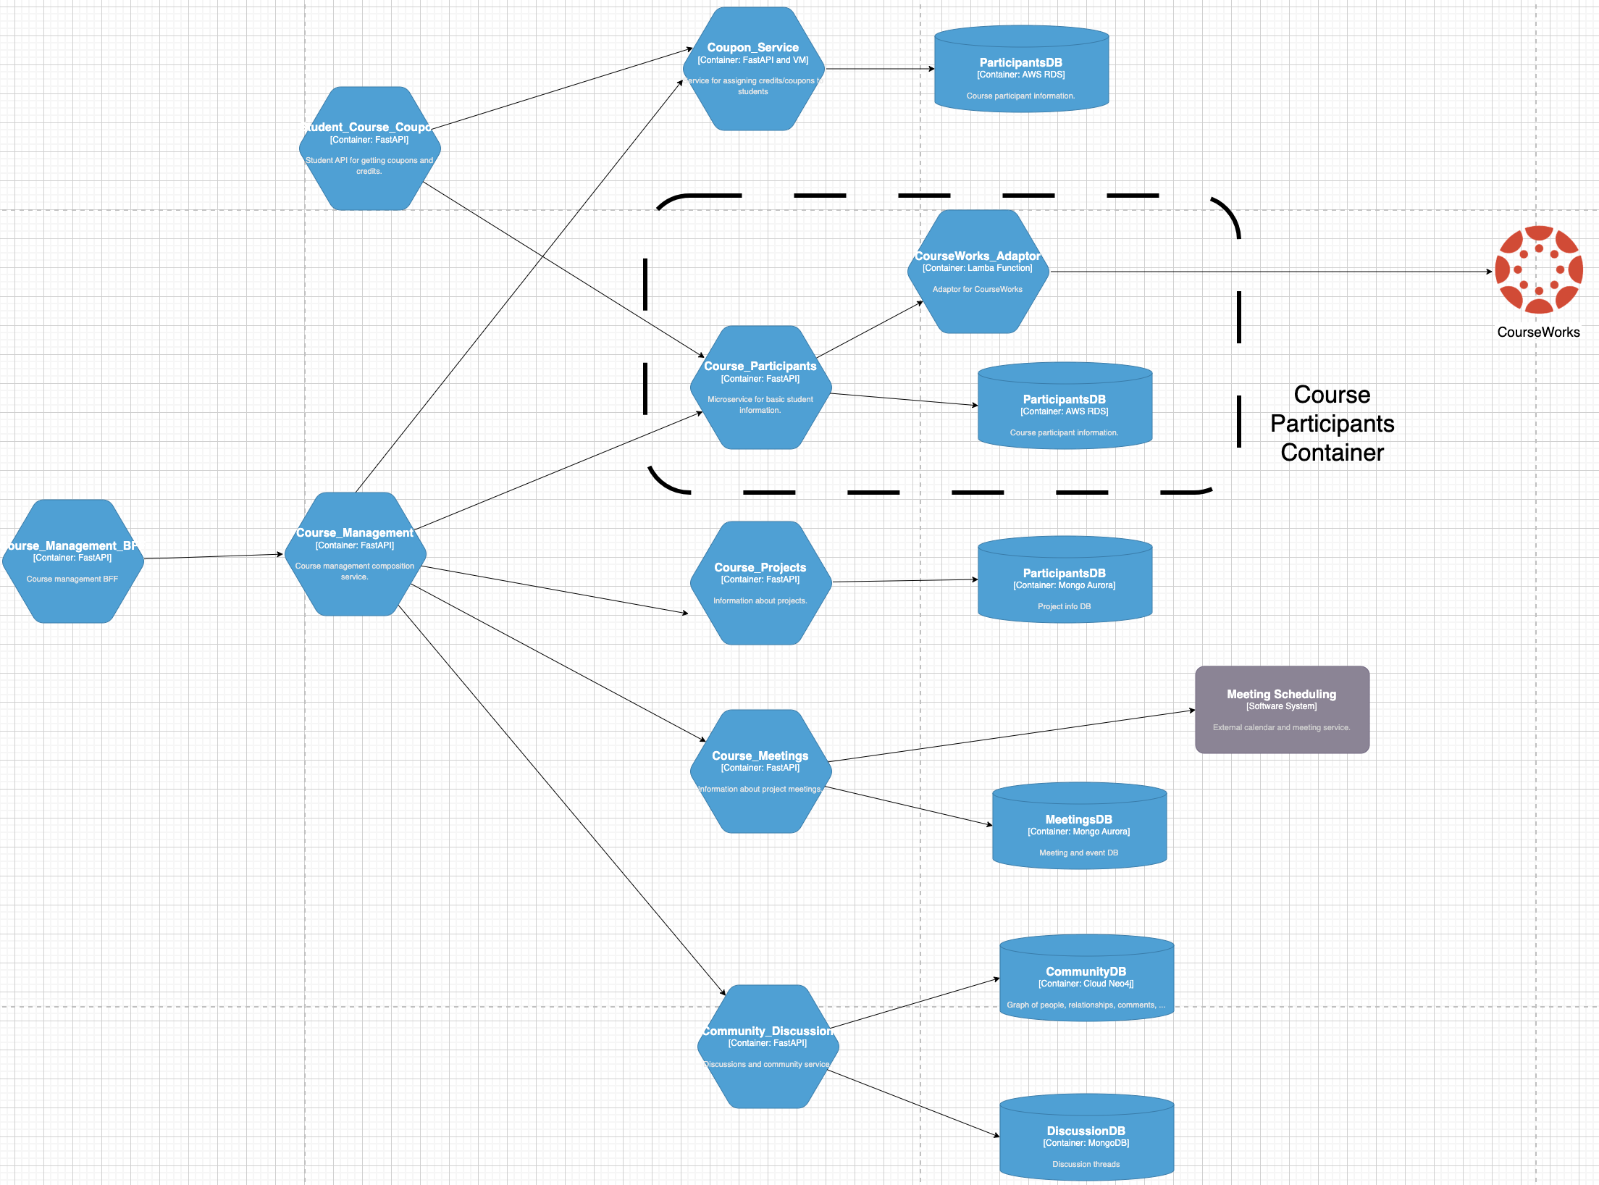
(Partial) Logical View – Interactive System

Slide 27
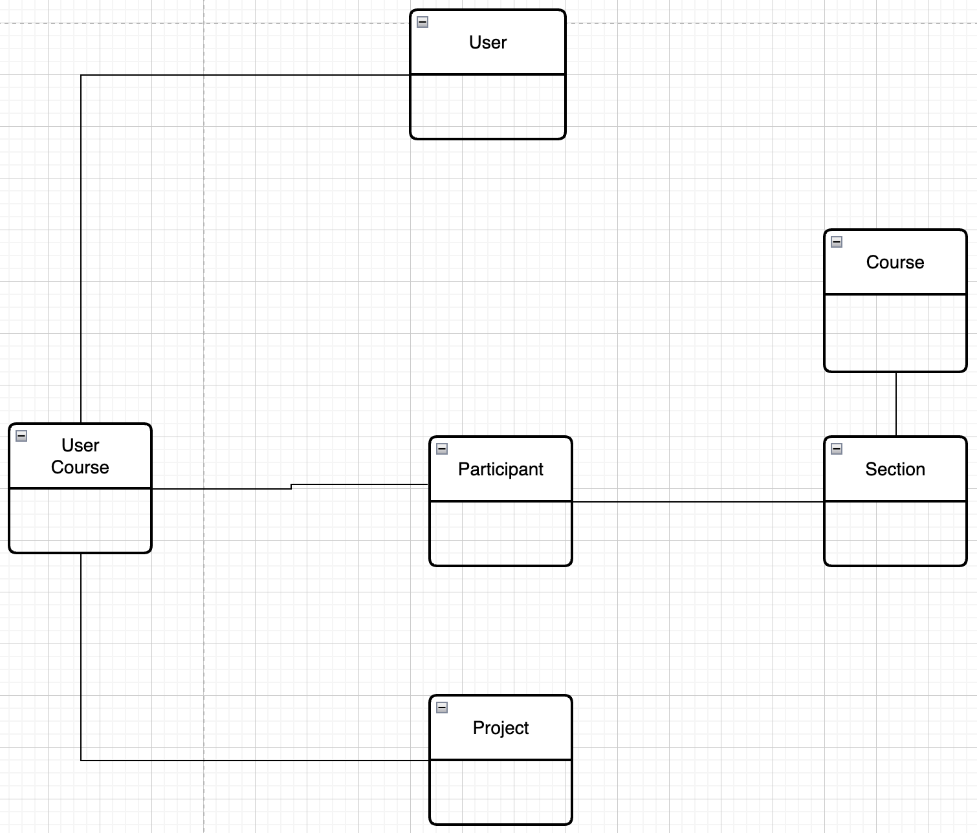
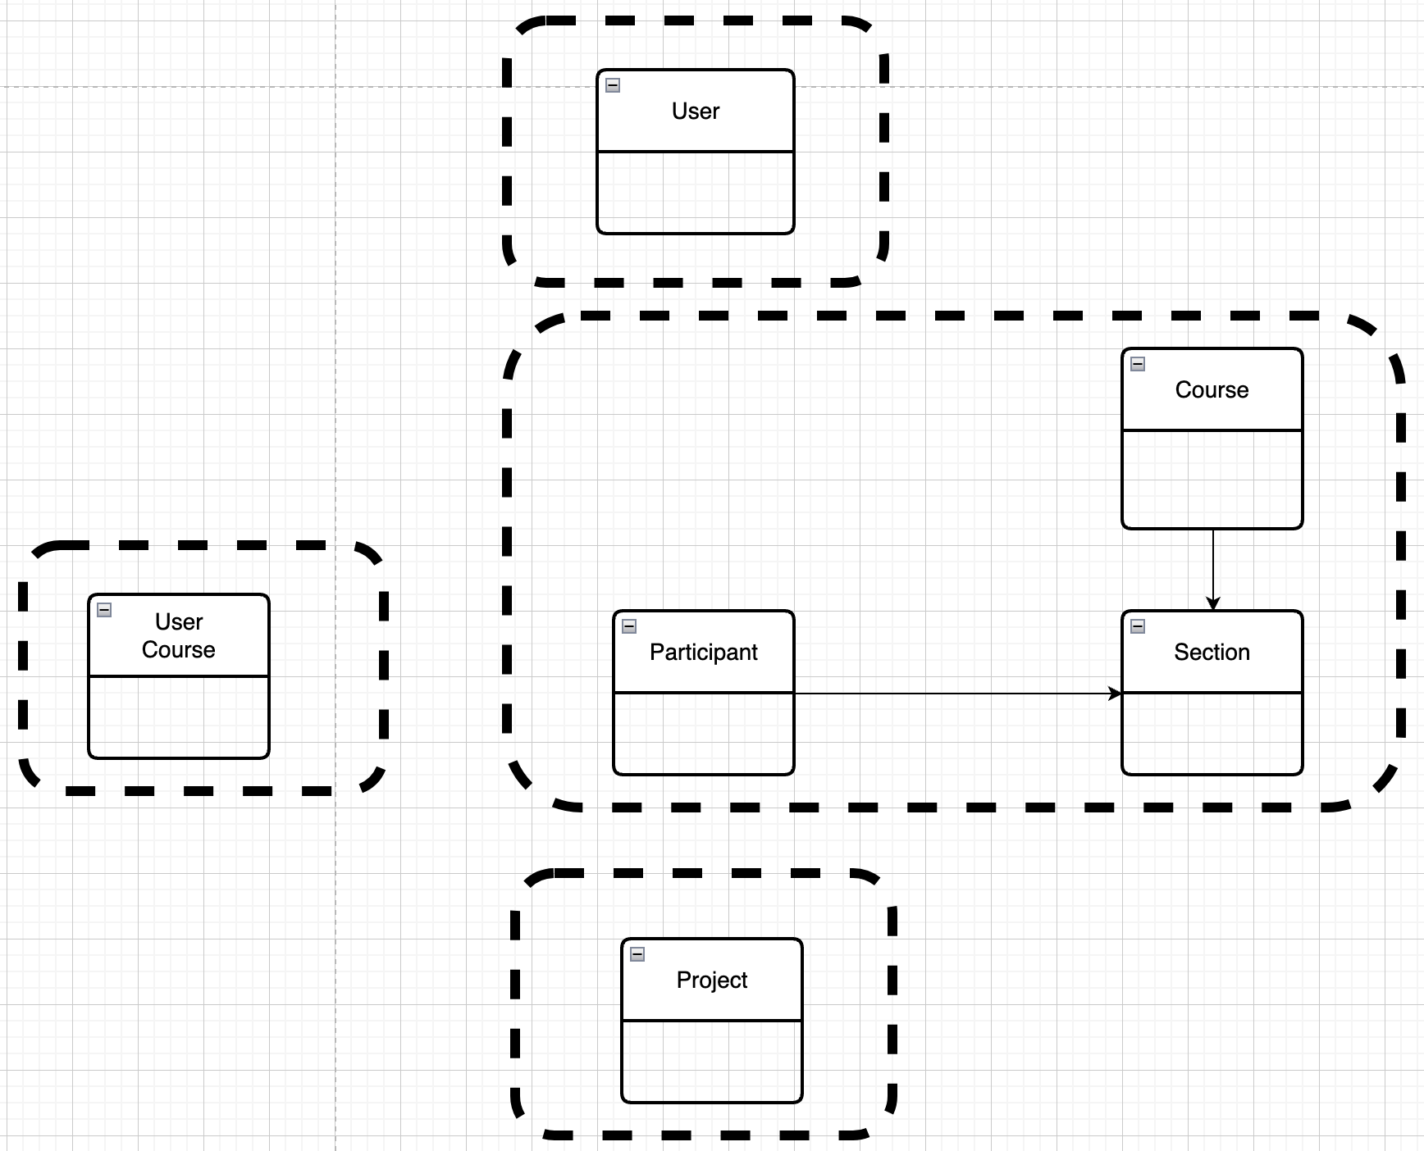
Resource Oriented and Microservices – My Project
Mapped to Microservices
Conceptual Model -- User, Project, Course
This creates some interesting challenges, e.g.
Joins
Foreign Keys
If the cluster of resources might be useful in other solutions → It may be a microservice.

Slide 28
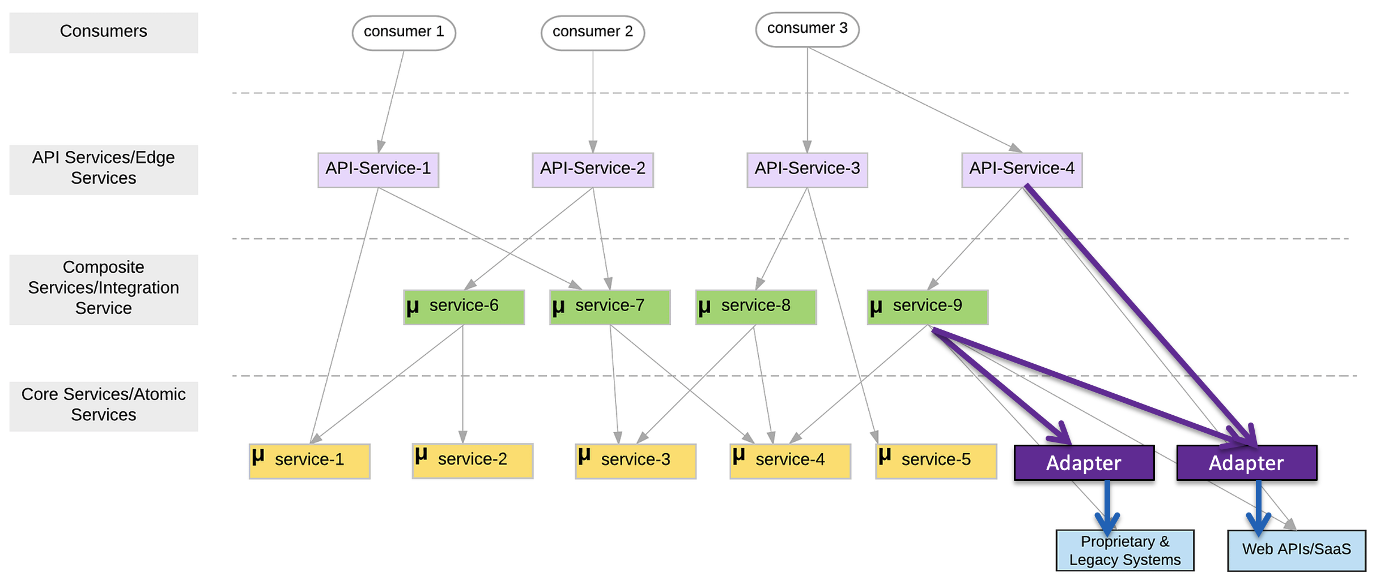
First Group of Microservices
My first sprint with have 5 microservices:
5 core/atomic microservices:
user_info
courseworks_adaptor
course_info
student_coupons
project_teams
1 composite/integration microservice: core_course_management
The composite service:
Implements “consistency” in the data in the core services, e.g. “foreign keys.”
Eliminates the need for complex logic in the UI or client, which would be impacted by changes.
Exposes only information from the basic services that the client requires.
The composite service is conceptually similar to a database view.

Slide 29
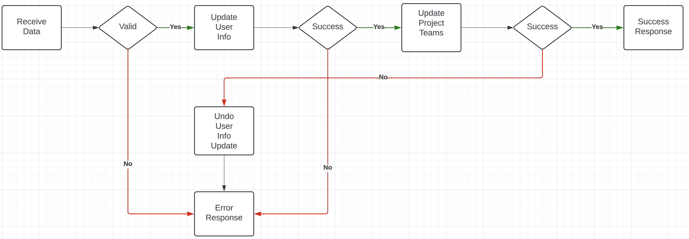
Composite Microservice Logic
The GET on the composite invokes GET on several atomic services. This can occur synchronously or asynchronously in parallel.
PUT, POST and DELETE are more complex. Your logic may have to undo some delegated updates that occur if others fail.
To get started, we will just use simple logic but explore more complex approaches.

Slide 30
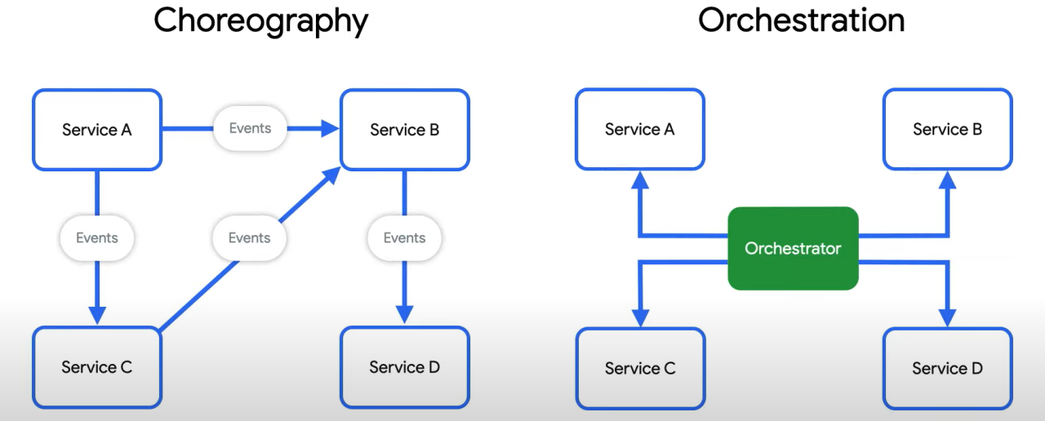
Behavioral Composition
There are two base patterns: choreography and orchestration.
There also several different implementation technologies and choices.
And many related concepts, e.g. Sagas, Event Driven Architectures, Pub/Sub, … …
We will cover and explore incrementally, but for now we will keep it simple and do traditional “if … then …” code.

Slide 31
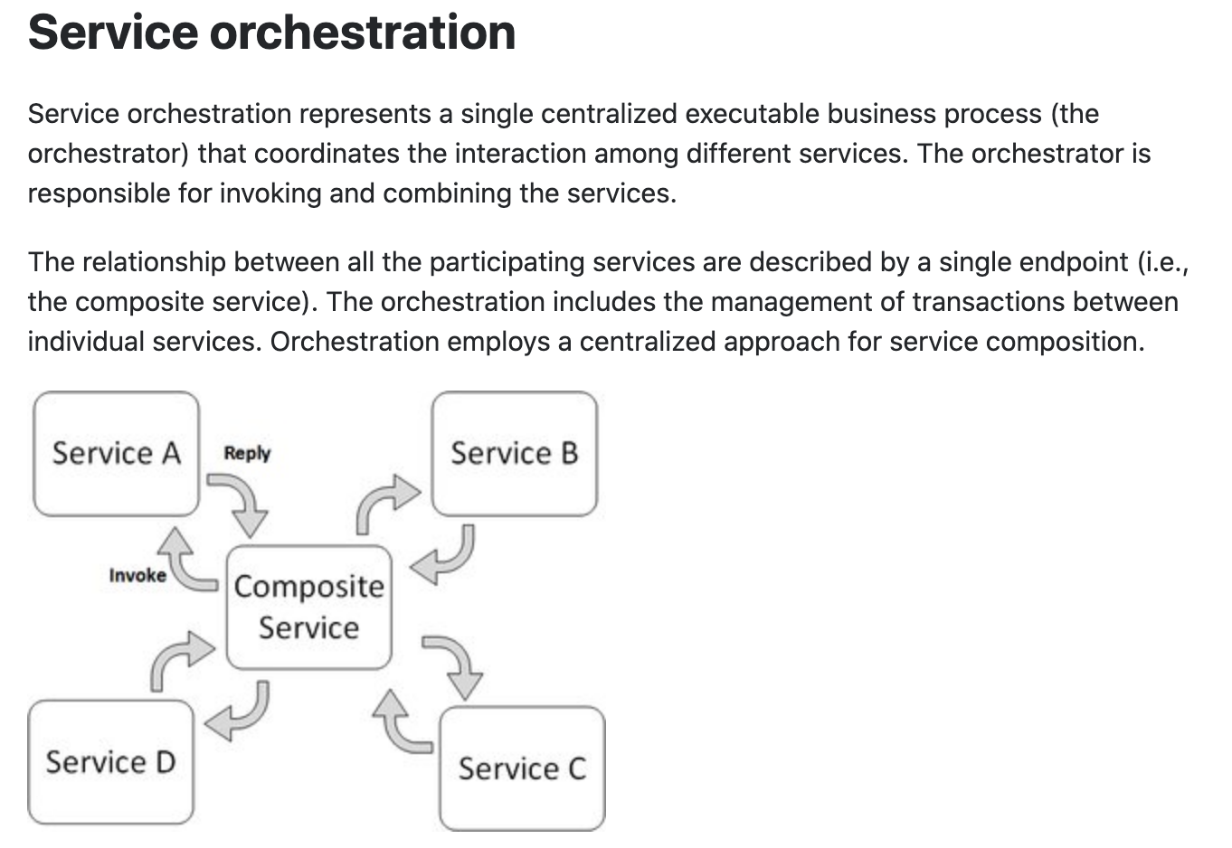
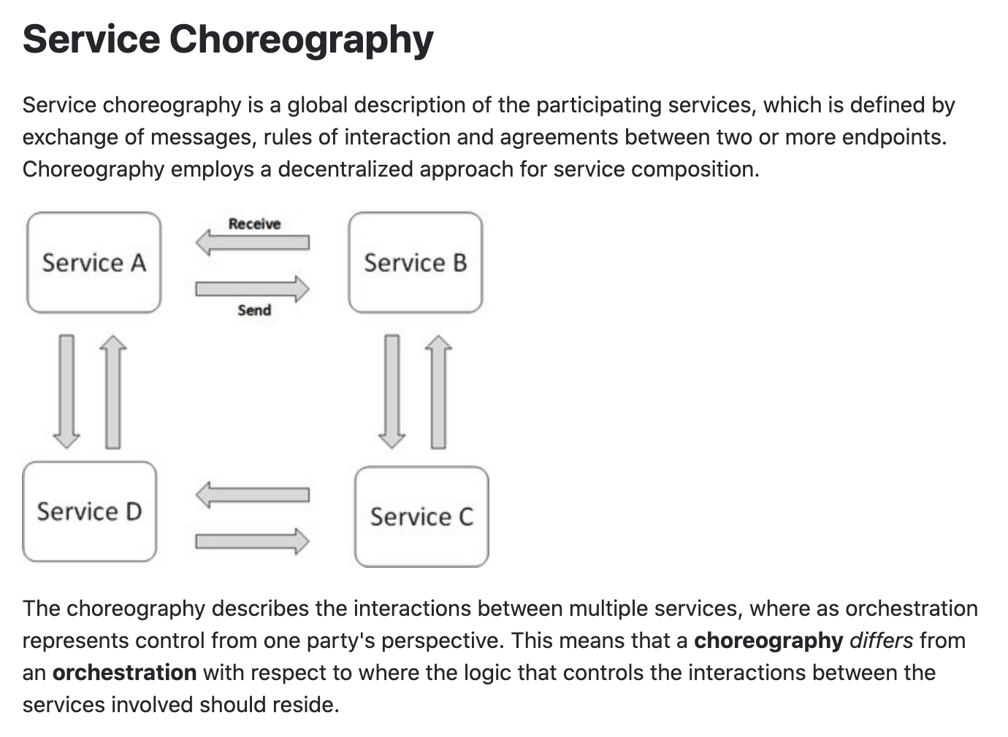
Concepts
These are not formally, rigorously defined terms.

Slide 32
In Code: Composition and Asynchronous Method Invocation
Composite operations can “take a while.”
“Holding open connections and waiting can be bad.”
Consumes resources.
Connections can break.
... ...
There are two options:
Polling
Callbacks
Our next pattern is composition and “polling.” Create a new user requires:
Updating the user database.
Verifying a submitted address.
Creating an account in the catalog service.
Request
202 ACCEPTED Location
GET (Poll)
200

Slide 33
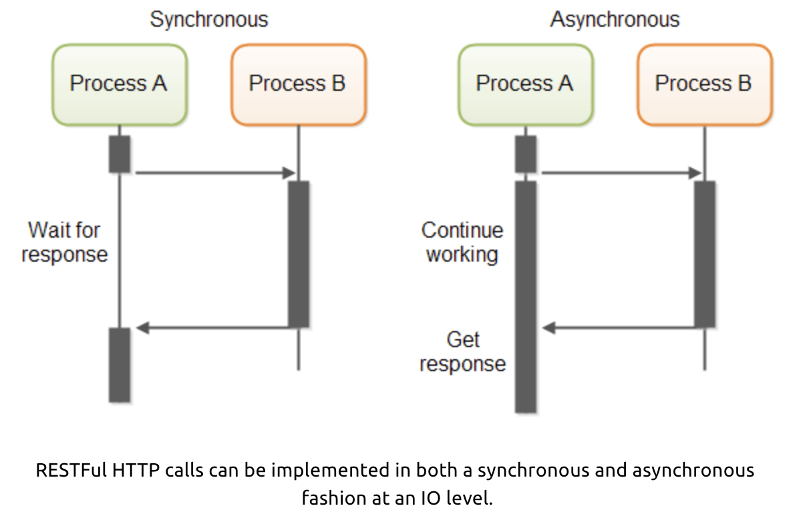
In Code: Service Orchestration/Composition
One call to a composite service
May drive calls to multiple other services.
Which in turn, may drive multiple calls to other services.
Synchronous (Wait) and calling one at a time, in order is
Inefficient
Fragile
... ...
Asynchronous has benefits but can result in complex code.

Slide 34
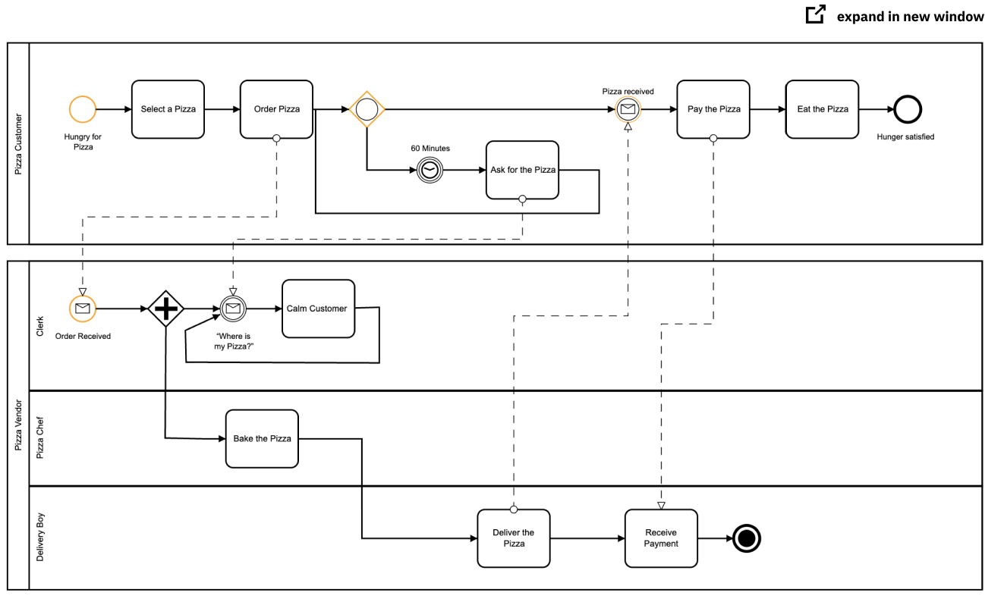
Service Orchestration
Implementing a complex orchestration in code can become complex.
High layer abstractions and tools have emerged, e.g. BPMN.
“Business Process Model and Notation (BPMN) is a graphical representation for specifying business processes in a business process model.”
There are products for defining BPMN processes, generating code, executing, … …, e.g. Camunda: https://camunda.com/bpmn/
There are other languages, tools, execution engines, … …

Slide 35
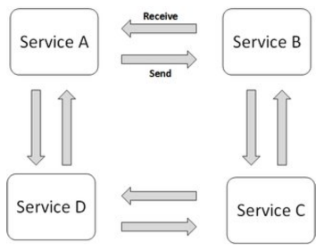
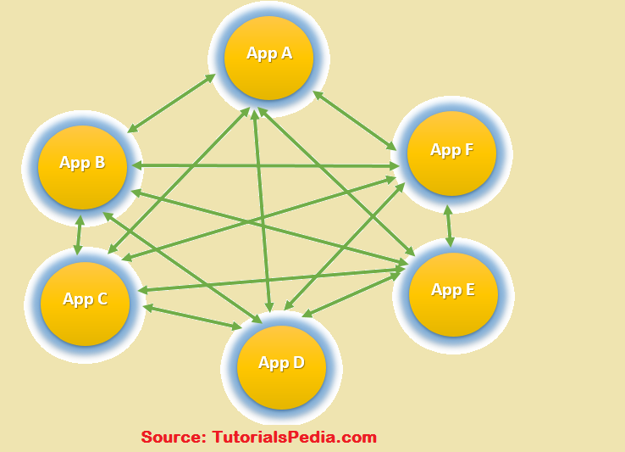
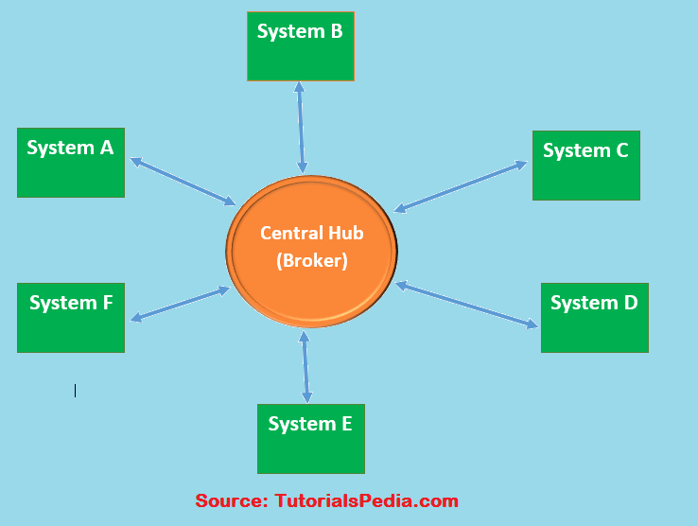
Choreography
We saw the basic diagram, but … this is an anti-pattern and does not scale.
But, how do you write the event driven microservices?
Well, you can just write code … …
Or use a state machines abstraction.

Slide 36
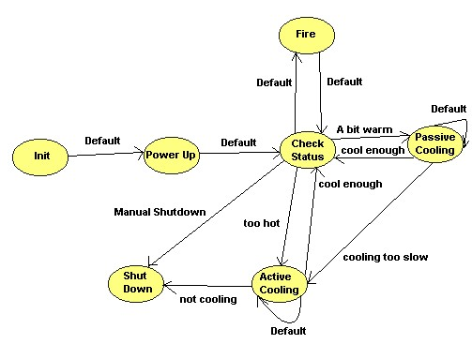
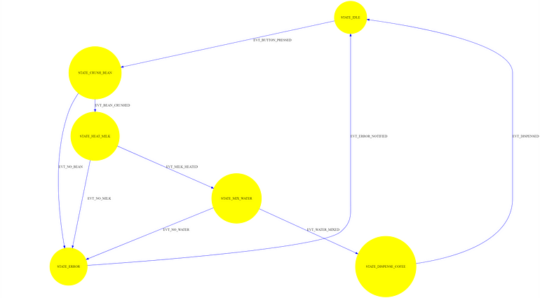
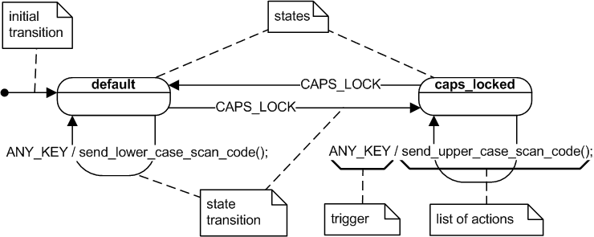
State Machine
A state machine is an abstraction.
There are many models for defining state machines.
There are also development tools, runtimes, … …
We will look at a specific example: AWS Step Functions

Slide 37
12 Factor Apps
SOLID
Introduction
37 | W4153-F24-4-Web-Content-Mictoservices-DB-Oauth2 © Donald F. Ferguson, 2024

Slide 38
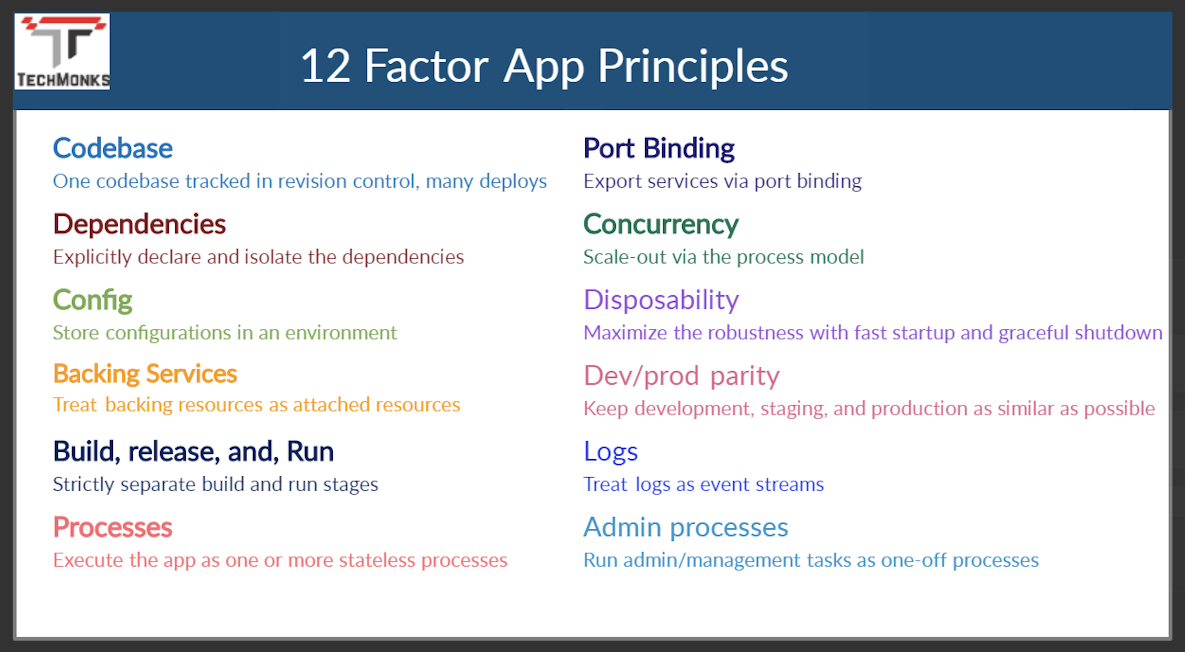
12 Factor Applications
https://dzone.com/articles/12-factor-app-principles-and-cloud-native-microser

Slide 39
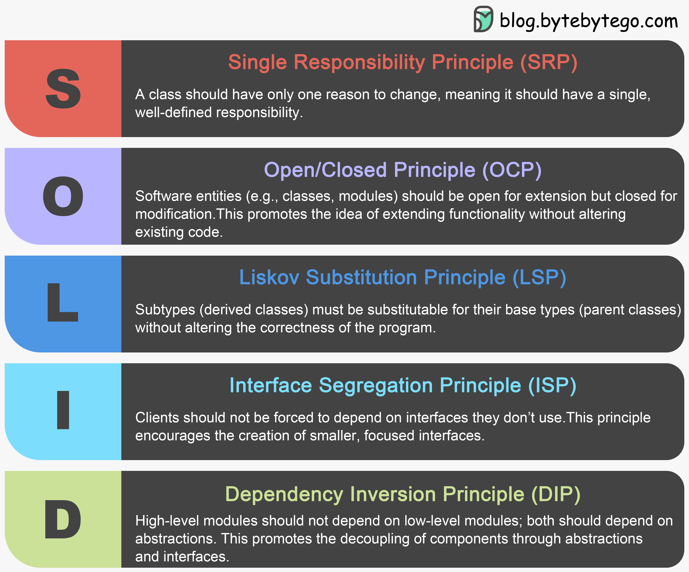
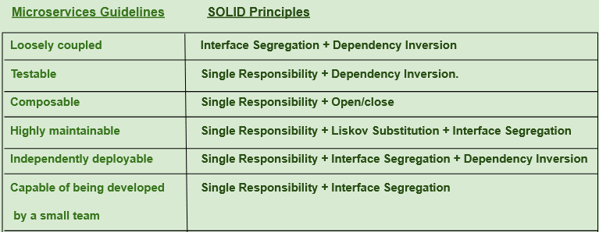
SOLID Principles
https://medium.com/@saurabh.engg.it/microservices-designing-effective-microservices-by-following-solid-design-principles-a995c3a033a0
This is a good overview article, and we will see patterns in later lectures.
This slide and the preceding slides could have been a 60 slide presentation.
If you put 3 SW architects into a room, you will get 15 design principles and patterns.
Use common sense.

Slide 40
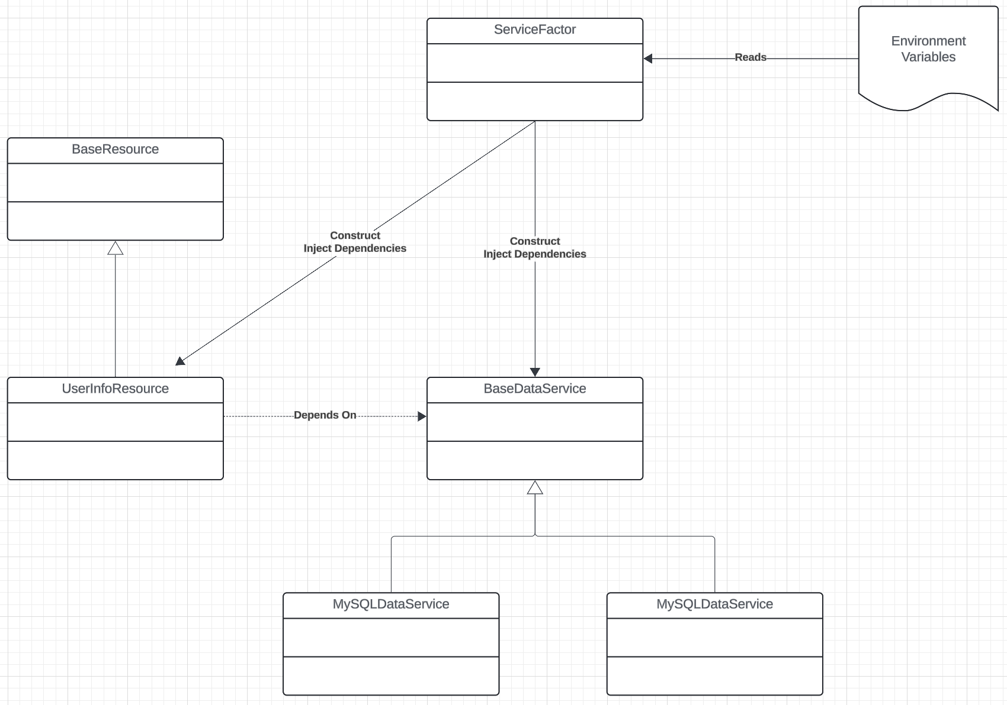
SW Architecture
Use interfaces, or the language equivalent/approximation.
A constructor receive a “config” object that is a dictionary of
Interface name.
Reference to implementation.
Parameters and configuration properties are also in the config, e.g.
URLs
“Passwords”
Database and table names
… …
A “service factory” creates the specific instances and configs, and wires it all together.

Slide 41
12 Factor Applications
https://dzone.com/articles/12-factor-app-principles-and-cloud-native-microser

Slide 42
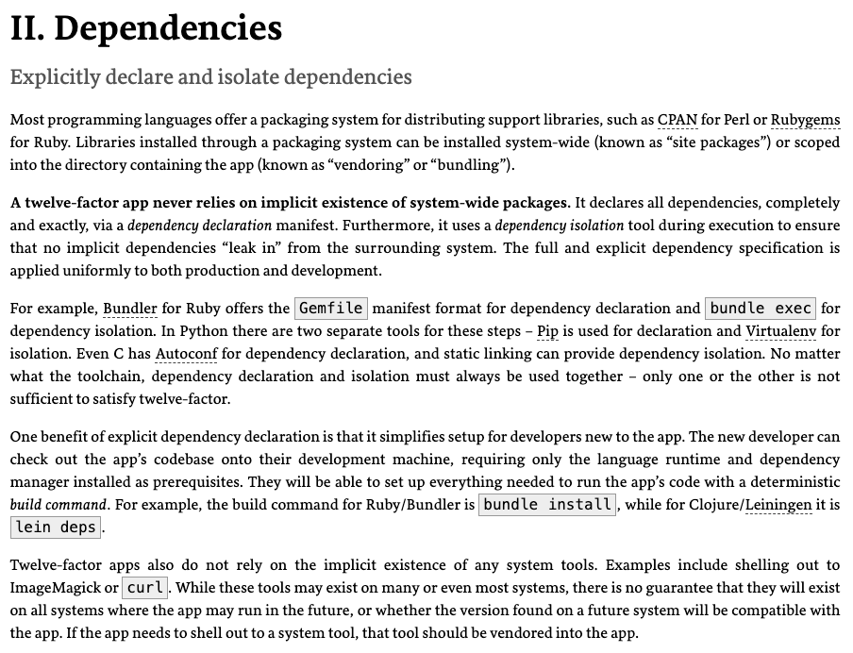
Dependencies
Most application frameworks have a dependency declaration concept.
I have been showing examples with:
Python import
requirements.txt
etc.
My examples also show encapsulating libraries and APIs with Python classes.
II. Dependencies handles “the code,” but we still need to handle the instance. There is a difference between, e.g.
pymysql
A specific connection.

Slide 43
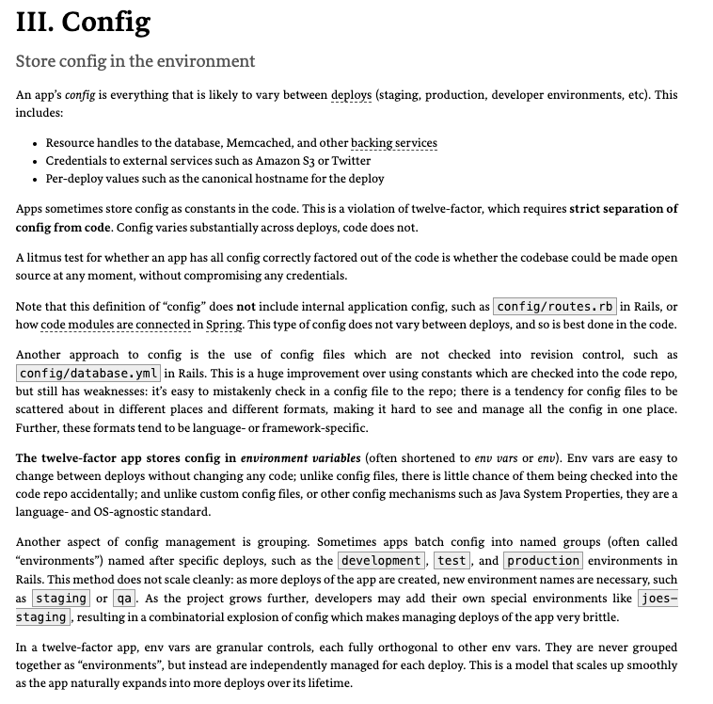
III. Configurations
Each of the deployment environments we have seen has a method for setting environment variables.
https://docs.aws.amazon.com/cloud9/latest/user-guide/env-vars.html
https://docs.aws.amazon.com/elasticbeanstalk/latest/dg/environments-cfg-softwaresettings.html
https://cloud.google.com/functions/docs/configuring/env-var
CI/CD, GitHub actions, etc. can integrate environment variables with the development process.
Vaults and secrets managers are a better approach for passwords.

Slide 44
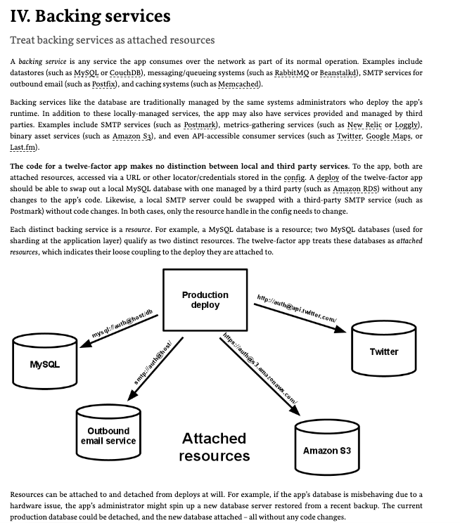
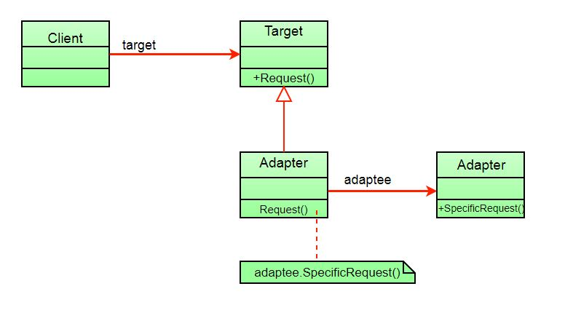
IV. Backing Services
My code has shown encapsulating backing services with a shallow adaptor.
This is an example of the adaptor pattern.
You seen examples of things like AbstractBaseDataService, … …
The approach is also an application of several aspects of SOLID. (https://en.wikipedia.org/wiki/SOLID)

Slide 45
Structural Composition
We can use four patterns/principles for service composition ”in code.”
Dependency Injection
Service Factory
Service Locator
Metadata in the environment for configuration.
I did some simple examples in https://github.com/donald-f-ferguson/E6156-Public-Examples/tree/master/old_examples/simple_pattern_examples.
Or actually, I asked ChatGPT to produce simple examples.
And, these are conceptual, and I am not super happy with them.

Slide 46
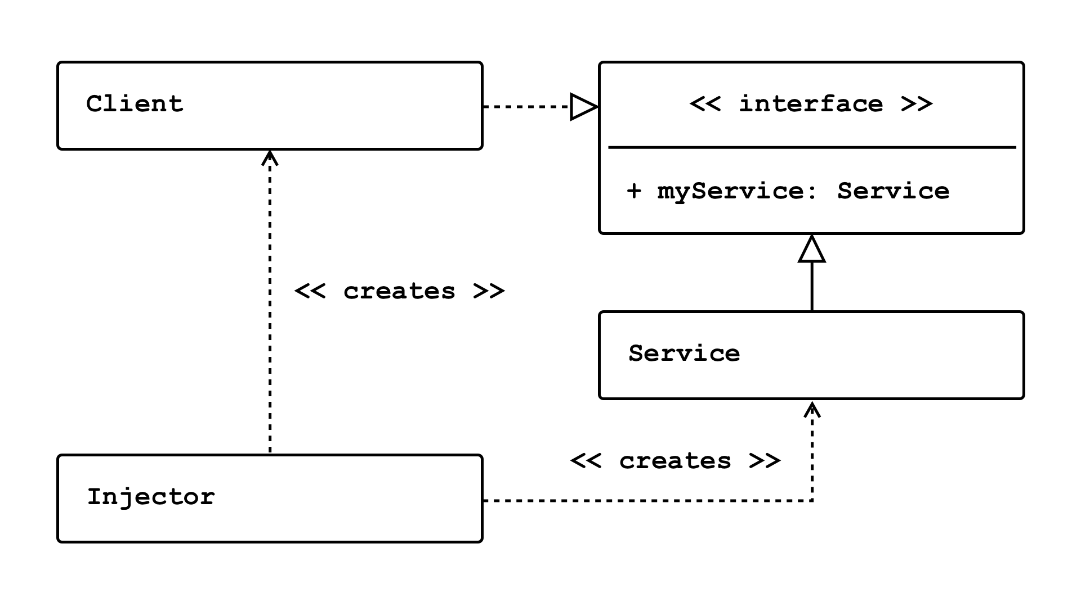
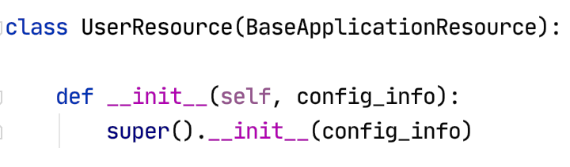
Dependency Injection
Concepts (https://en.wikipedia.org/wiki/Dependency_injection):
In software engineering, dependency injection is a technique in which an object receives other objects that it depends on, called dependencies.
The intent behind dependency injection is to achieve separation of concerns of construction and use of objects. This can increase readability and code reuse.
There is no single approach. There are several frameworks, tools, etc.
Like many other things, it is easy to get carried away and become dogmatic.
I follow a single approach:
A Context class converts environment and other configuration and provides to application.
The top-level application injects a config_info object into services.

Slide 47
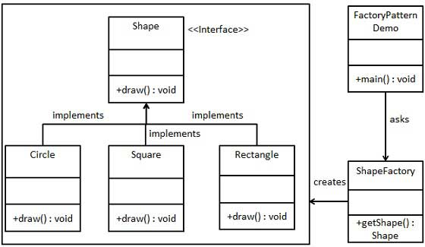
Service Factory
“In class-based programming, the factory method pattern is a creational pattern that uses factory methods to deal with the problem of creating objects without having to specify the exact class of the object that will be created. This is done by creating objects by calling a factory method—either specified in an interface and implemented by child classes, or implemented in a base class and optionally overridden by derived classes—rather than by calling a constructor.” (https://en.wikipedia.org/wiki/Factory_method_pattern)
You will sometimes see me use this for
Abstraction between a REST resource impl. and the data service.
Allows changing the database service, model, etc. without modifying the code.
Concrete implementation choices are configured via properties, metadata, …
You can use in many situations.
https://www.tutorialspoint.com/design_pattern/factory_pattern.htm

Slide 48
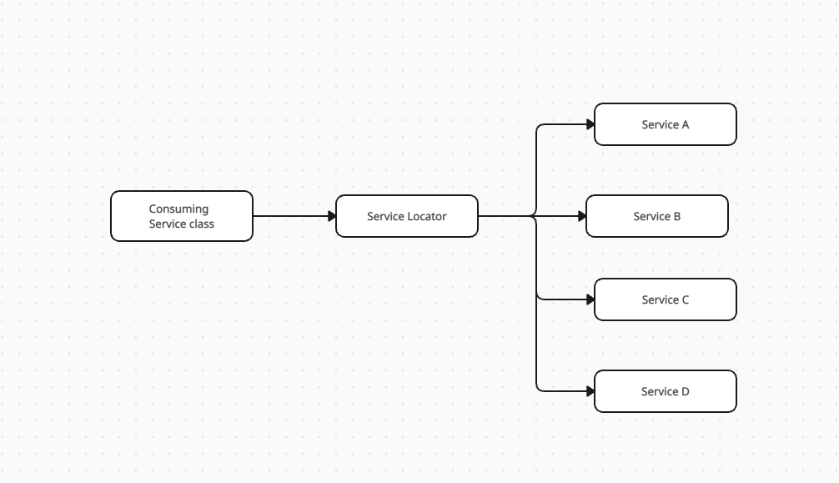

Service Locator
“The service locator pattern is a design pattern used in software development to encapsulate the processes involved in obtaining a service with a strong abstraction layer. This pattern uses a central registry known as the "service locator", which on request returns the information necessary to perform a certain task. Proponents of the pattern say the approach simplifies component-based applications where all dependencies are cleanly listed at the beginning of the whole application design, …” (https://en.wikipedia.org/wiki/Service_locator_pattern)
Configuration Information

Slide 49
Where Are We Going With All Of This?
49 | W4153-F24-4-Web-Content-Mictoservices-DB-Oauth2 © Donald F. Ferguson, 2024

Slide 50
Diagrams
Diagram the logical model of the first application
Talk about deployment options.

